Slide 1
Campus Social Life on
the Weekends
Alexi Warkentin, Aynslee Barber, Delainy Carroll, Mars Pejović, Rosine Hamadi
University of Mary Hardin-Baylor Research Methods for the Social Sciences ‘23
Notes:
Intro: Ayns
Names, Rosine: ending and transition to research goal

Slide 2
Research Goal
We wanted to study how students feel about campus social life on the weekends.
-HUMAN RESOURCES DEVELOPMENT-
-HUMAN RESOURCES DEVELOPMENT-
Notes:
Rosine

Slide 3




Methodology
Systematic Cluster Sampling
Snowball Method
Semi-Structured Interviews
Thematic Coding
Notes:
Mars
Systematic clustered sampling of on campus housing (apartments, dorms) -we clustered by residence hall with permission and knocked on doors, Snowball sampling (commuters, on campus houses)-hard to reach, semi-structured interviews, thematic coding in dedoose, cut sheets,

Slide 4
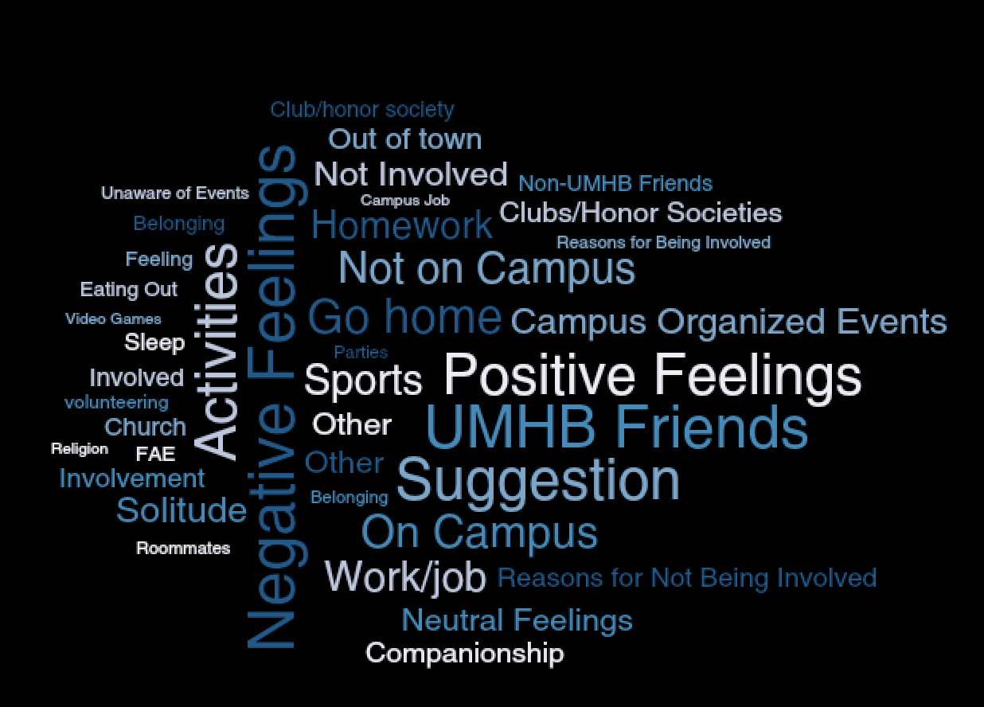
Notes:
Mars

Slide 5
Interview
Questions
Notes:
Mars

Slide 6
How do you feel about campus social life on the weekends?
Notes:
Mars

Slide 7
What do you like and dislike about campus on the weekends?
Notes:
Ayns, allowed students to discuss their feelings and think about their own experiences

Slide 8
What do you do on the weekends?
Notes:
Rosine

Slide 9
Do you have any suggestions?
Notes:
Delainy
This gave students the opportunity to express what they’d like to see implemented on campus over the weekends.

Slide 10
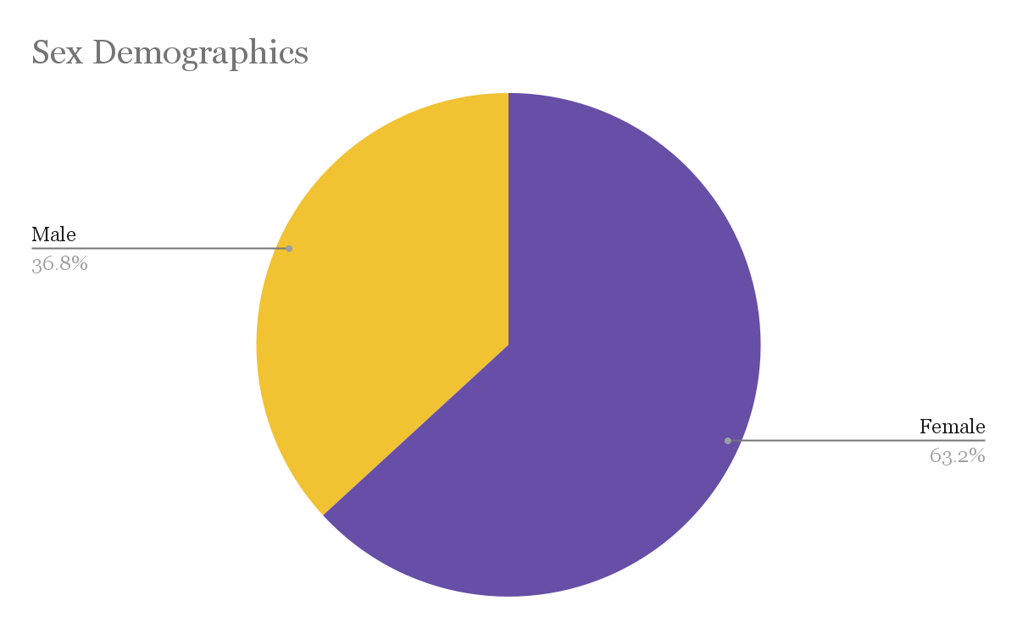
N=20
Notes:
Alexi (20 interviewees)
36.8% male; 63.2% female

Slide 11
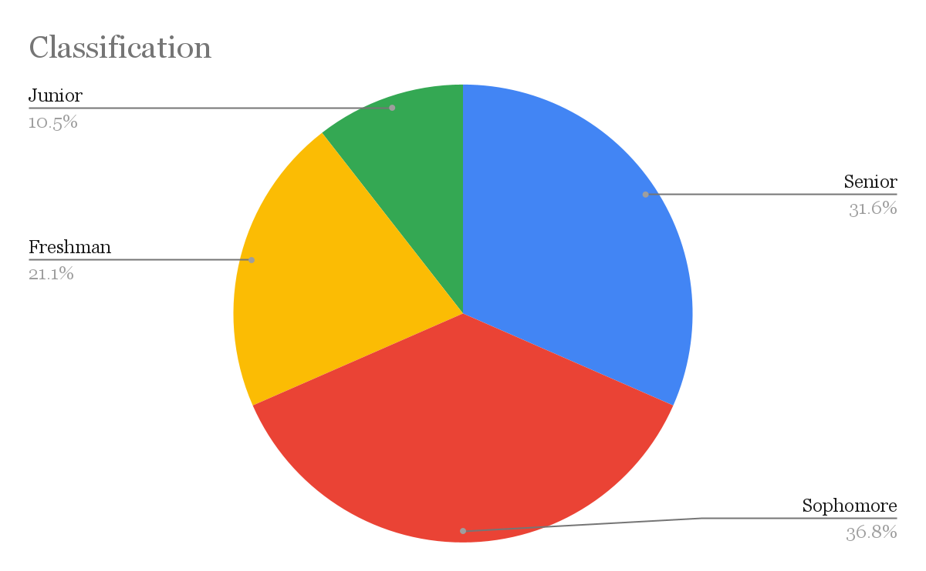
Notes:
Alexi
21.1% freshman; 36.8% sophomore; 10.5% junior; senior 31.6%

Slide 12
Thematic Findings
Activities
Belonging
Advertising
Notes:
Delainy
“Across the 20 interviews we conducted, the most prominent thematic findings were…”

Slide 13
Belonging ,
Notes:
Mars & Rosine

Slide 14



Feelings of Isolation
Impact of Friendship
Diversity Concerns
Key Findings
Notes:
Mars & Rosine

Slide 15
“So definitely had a very positive impact on my experience and all the Burt girls, I love everyone here so much. Like everyone's so sweet. My RAs, even my RAs that aren't my specific RA. I just, I love them so much. I can't say enough positive things about the community here”
-Ingrid, student
*All names are pseudonyms
Notes:
Mars
She went on to say how friendly everyone around campus is, and that she keeps in close contact with many of the individuals from her welcome week group. She also stated she was more involved with campus activities and went to the events such as the Spare Time event that took place. She also talks about how she is involved with many campus directors/RD’s and this is where she gets info about activities.

Slide 16
“ I dislike how it's not really as diverse and there's only certain things like you can be a part of”
-Rachel, African American female
Notes:
Mars
This individual was a African American female, and stated that a lot of individuals didn’t look like her and it felt hard to fit in. She felt like weekend life was “dead” she felt like clubs were more focused on academic feats rather than individual’s interests

Slide 17
"I'd rather not stay on campus because there’s nothing to do there. All the fast food restaurants are closed, and the only thing to eat is in Bawcom, which is gross. And there is nothing happening on campus. There isn’t even a sporting event. Overall I just don't feel like I fit in here.”
-Stevie, Freshman Johnson Hall
Notes:
maybe like some weekend events to keep people on campus because the reason why a lot of people will tend to leave is because there's nothing to do on campus. Literally all the fast food, all the fast food, all the places to eat on campus are closed. So people, a lot of people, especially the people in the dorms, they have nothing else to eat except for bottom and bottom sucks. So they feel like they have to go somewhere else to get food. There's nothing to do here. So they leave and then they just feel like they don't want to come back because there's nothing to do here. So if they could, like I don't know, do like a movie event in one of the buildings or something like that, or a cute little like carnival or something on the weekend, just like more interaction so people would want to stay
maybe like some weekend events to keep people on campus because the reason why a lot of people will tend to leave is because there's nothing to do on campus. Literally all the fast food, all the fast food, all the places to eat on campus are closed. So people, a lot of people, especially the people in the dorms, they have nothing else to eat except for bottom and bottom sucks. So they feel like they have to go somewhere else to get food. There's nothing to do here. So they leave and then they just feel like they don't want to come back because there's nothing to do here. So if they could, like I don't know, do like a movie event in one of the buildings or something like that, or a cute little like carnival or something on the weekend, just like more interaction so people would want to stay

Slide 18
''What I like is, it's like a family environment, But I do wish the was inclusive to people who look like me. I'm a black man at a PWI [Predominately White Institution] which limits me engaging with my classmates because of cultural differences. You know, everybody knows each other is a smaller school. So, you know, a lot of familiar faces, easy to get comfortable.”
Ethan, African American male
Notes:
Mars & Rosine
African American finding it hard to fit in or get involved on campus

Slide 19
Activities ,
Notes:
Ayns, second theme of activities

Slide 20




Job/Career
Clubs/Honor Societies
Off Campus Activities
On Campus Activities
Key Findings
Notes:
Ayns
Indicators

Slide 21
“People stray away from putting activities on the weekends. Like, it seems like all the events are on Tuesdays or Thursdays… I wish one organization would do something on Saturdays.”
-Marvin, FYC member
Notes:
Alexi & Ayns
Too much to do during the week
Nothing on the weekends

Slide 22
“Just more options, more opportunities, and more variety.”
-Clarity, student
Notes:
Clarity’s sister has wrist issues and can’t participate in rec activities

Slide 23
“[Students] know people leave on the weekends, so they don’t have to be here.”
-Nathan, Sodexo Worker
Notes:
School expectations vs student expectation
Cycle

Slide 24
“We just kind of are off doing our own thing, like catching up on sleep and just trying to catch up on homework.”
-Giselle, highly involved student
Notes:
Alexi & Ayns

Slide 25
Advertising ,
Notes:
Delainy

Slide 26



Key Findings
Unawareness of Events
Lack of Activity Attendance
Scheduling Conflicts

Slide 27
Interview Question: What UMHB events have taken place on the weekends that you have gone to?”
“I didn’t know we had any on the weekends.”
Interview Question: “How do you feel about these events?”
“Again, I didn’t know.”
-Giselle, highly involved student
Notes:
Delainy

Slide 28
Interview Question: “So what would you change about activities on the weekends?”
“I guess because me personally, I don’t know [about the events]... I know they have the chalkboards up in Bawcom, but if you don’t pass Bawcom, you won’t know.”
- Bart, Sophomore in College View
Notes:
Delainy
Relate, endless scroll

Slide 29
“I know some people who can't even do some of the events because of sports, and other activities. So maybe if events were scheduled in ways that everyone can attend, they'd be a lot more impactful on student life.”
- Penelope, Sophomore

Slide 30
Implications & Recommendations
Notes:
Mars

Slide 31
Increasing student belonging
Notes:
1. Mars

Slide 32
''But if they can have more groups that are outside of like religion and outside of academics, that would be nice.”
-Quinn, Freshman in Johnson Hall
Notes:
Quinn stated that she wished their events such as Greek life or things to foster diversity and community to feel more connected and have students connect to one another

Slide 33
2. Creating events for the weekends

Slide 34
Interview Question: “What would you change about campus weekend activities?”
“Honestly, just have activities”
Giselle, highly involved student

Slide 35
3. Making effective advertisement for weekend events/activities

Slide 36
“ I would just say, just make it more known.“
- Bart, Sophomore in College View
Notes:
Delainy

Slide 37
So, what now?
Notes:
Ayns

Slide 38
Activities
Belonging
Advertising
Notes:
Increasing belonging, making and placing activities and events on the weekends, and creating effective advertising

Slide 39
Thank you so much!
We would love to answer any questions you may have.
Notes:
Rosine

